Slide 1
Economics & markets
policy update webinar
February 14, 2024

Slide 2
agenda
10:30 Economics & Markets Policy Update
Andrew MacNish Porter
Senior Policy Manager – Economics & Markets, SR
ScotGov/CXC LMP review
CfD SIR consultation
CfD AR7 and future rounds consultation
LDES consultation
10:50 Coming Up
Economics & Markets
Upcoming Events
Meeting Close
10:00 Welcome & Introductions
Optimise your SR membership
SR Team Growth
10:10 Constraint Management Market Report Presentation
Simon Gill
Independent Consultant, The Energy Landscape

Slide 3
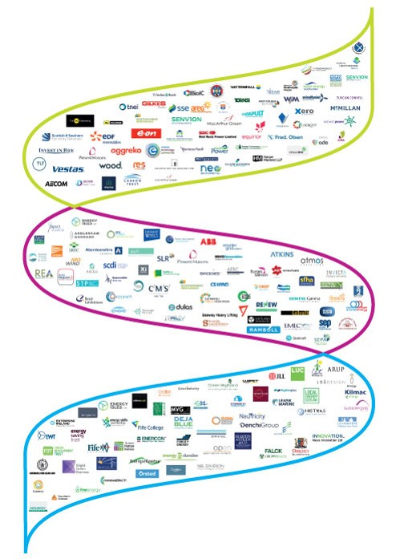
your trade body
Scottish Renewables is the voice of Scotland’s renewable energy industry. Our vision is for Scotland to lead the world in renewable energy.
We work to grow Scotland’s renewable energy sector and sustain its position at the forefront of the global clean energy industry.
We represent 350+ organisations that deliver investment, jobs, social benefit and reduce the carbon emissions which cause climate change.
Our members work across all renewable energy technologies, in Scotland, the UK, Europe and around the world.

Slide 4
WHAT WE DO
Create a policy environment that supports the renewables industry
Provide accurate information to media and decision-makers + challenge inaccurate information
Run a programme of international conferences and events where industry comes together
Provide a support service to our members

Slide 5
How we work
Assert the key importance of renewable energy and all the benefits it delivers
Monitor policy and politics to identify and use opportunities to influence policy
Gather intelligence on how policy is playing out in the real world and what needs to change
Monitor the media to input good news stories and challenge inaccurate stories
Build relationships with key stakeholders and build their understanding of and support for renewables

Slide 6
INFLUENCING POLICY
Scottish Renewables organises its policy work into 11 Forums
Economics & Markets | Grid & Systems | Hydro | Hydrogen | Low-Carbon Heat | Offshore Wind | Onshore Wind | Planning & Consents | Solar | Supply Chain | Marine (Wave & Tidal)
Forums are emailing lists that members can join to engage with SR’s work to influence policy.
THE KEY TO ENGAGING WITH SR’S WORK TO INFLUENCE POLICY
IS TO MAKE SURE YOU ARE ON OUR FORUM LISTS.
CHECKLIST
Set up an account on the SR website (this is open to all staff of SR member companies)
Make sure you keep your details up to date – especially your accurate job title and email address
Select the Forums that you are interested in
Register for our quarterly Policy Update Webinars (this is a Policy Update Webinar)

Slide 7


Set up your sr account
1. Click this
2. Choose this

Slide 8
Keeping updated
MONTHLY BRIEFING
At the start of every month, we will send you an email with a digest of all the policy and advocacy work the SR team has undertaken on behalf of members, organised under the different Forums - this will include links to key documents, requests for member input and will identify which member of the SR team is leading on each issue.
QUARTERLY
We will hold an online Policy Update Webinar (like this one) for the various Forums. Any member of staff of an SR member company can attend and each member company can have as many of their staff attend as they want. These webinars will provide an update on what is happening in the policy space, the key things you need to know about and what actions SR are taking on your behalf.
WHEN NEEDED
When we need to share time-sensitive information with you that can’t wait for the next Monthly Briefing, we will send an email to the relevant Forum. This is usually when we are writing a consultation response, and we have an 8, 12 week or less window in which to respond.
CONTACT US
If you come across an issue that is affecting the renewable energy industry (or part of it) in Scotland, please contact the relevant member of the SR team to let them know.

Slide 9
RESPONDING TO CONSULTATIONS
When a consultation or call for views is launched that is relevant to Scottish Renewables’ members, we usually have 8 or 12 weeks (or less) to respond.
We set deadlines to receive member inputs to ensure we respond in time.
Collating member inputs and synthesising them into consensus positions is the mainstay of the policy team’s work and requires a sizable percentage of our time. Members can make this process much more efficient by sticking to the deadlines we set and submitting their inputs in the requested tracked changes format.
Consultation link emailed to Forum with request for initial comments
TFG* meeting held to gather ‘rapid response’ from expert members –used to write the first draft
First draft of response emailed to relevant Forum for input and feedback
Second draft produced in response to feedback and circulated to Forum for final input and feedback
Response finalised and submitted. Also posted to SR website and included in Monthly Briefing
Every SR member company can input here…
here…
and here
*Task & Finish Group – the new name for SR Working Groups (2024)

Slide 10
Task & finish groups
Policy Working Groups (PWGs) and Task & Finish Groups (TFGs) enable the SR policy team to get expert input to help them draft consultation responses that can be shared with the SR membership for input and feedback.
We choose individuals to sit on PWGs & TFGs based on their track record of inputting into the SR policy work.
WE LOOK FOR INDIVIDUALS THAT:
Submit comprehensive responses to SR requests for member input at steps 1, 3 and 5 of our consultation response process.
Meet the deadlines for member input where applicable.
Have specific expertise on the policy issue(s) in question.
Can reliably attend regular meetings and make proactive contributions or notify in advance of a suitable alternate who will attend.
Consultation link emailed to Forum with request for initial comments
TFG meeting held to gather ‘rapid response’ from expert members –used to write first draft
First draft of response emailed to relevant Forum for input and feedback
Second draft produced in response to feedback and circulated to Forum for final input and feedback
Response finalised and submitted. Also posted to SR website and included in Monthly Briefing
Every member company can input here…
here…
and here

Slide 11
Scottish Renewables: communications Team
Communications team
Jack Norquoy | Public Affairs Manager
Laura Russell | Communications Manager
Nick Sharpe | Director of Communications & Strategy
Ewen McInnes | Media Manager
Ella Field | Communications Officer
Energy Transition and Supply Chain team
Emma Harrick | Head of Energy Transition & Supply Chain
Antigoni Markitani | Supply Chain Officer - Marketing & Events
Sophie Pacitti | Supply Chain Officer - Stakeholder Engagement

Slide 12
Scottish Renewables: POLICY Teams
policy team - onshore
policy team - offshore
Starts 19 Feb 2024
Megan Amundson
Senior Policy Manager – Onshore Wind & Consenting
Morag Watson | Director of Policy
Helen Melone
Senior Policy Manager – Heat & Solar
Mark Richardson
Senior Policy Manager – Offshore Enabling
Colin Palmer | Director of Policy
Maggie Olson
Policy Manager – New Technologies
(H₂, INTOG, Marine)
Covers Pumped Storage Hydro
Stephen McKellar
Senior Policy Manager – Grid & Systems
Holly Thomas
Policy Manager
– Grid & Systems
Katy Barrie
Policy Admin Officer
Andrew MacNish Porter Senior Policy Manager
– Economics & Markets
Starts 8 Jan 2024

Slide 13
Exploring the options for constraint management markets in the gb electricity system
Simon gill
Independent consultant, The Energy Landscape

Slide 14

Exploring options for constraint management in the GB electricity system
A report for Scottish Renewables
Dr. Simon Gill
The Energy Landscape Ltd
simon@energylandscape.co.uk

Slide 15
Constraint costs have gone up in recent years
Volume X Unit cost = Total cost
5.0
4.5
4.0
400
1600
350
1400
300
1200
3.5
3.0
2.5
2.0
Unit cost (£/MWh)
250
Volume (TWh)
Cost (£million)
1000
200
800
150
600
1.5
1.0
0.5
100
400
50
200
0.0
0
0
2017-2018 2018-2019 2019-2020 2020-2021 2021-2022 2022-2023
2017-2018 2018-2019 2019-2020 2020-2021 2021-2022 2022-2023
2017-2018 2018-2019 2019-2020 2020-2021 2021-2022 2022-2023
Due almost entirely to increases in the cost of gas-turn up to replace curtailed wind I expect constraint costs to come down for the year 2023/24

Slide 16
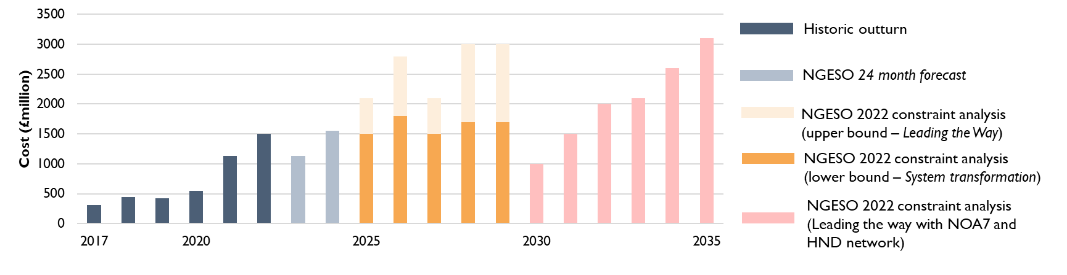
And constraint volumes are likely to increase in the come years
Although there is significant uncertainty over the exact volume depending on the development of GB generation, flexiblity and our success at building new transmission

Slide 17
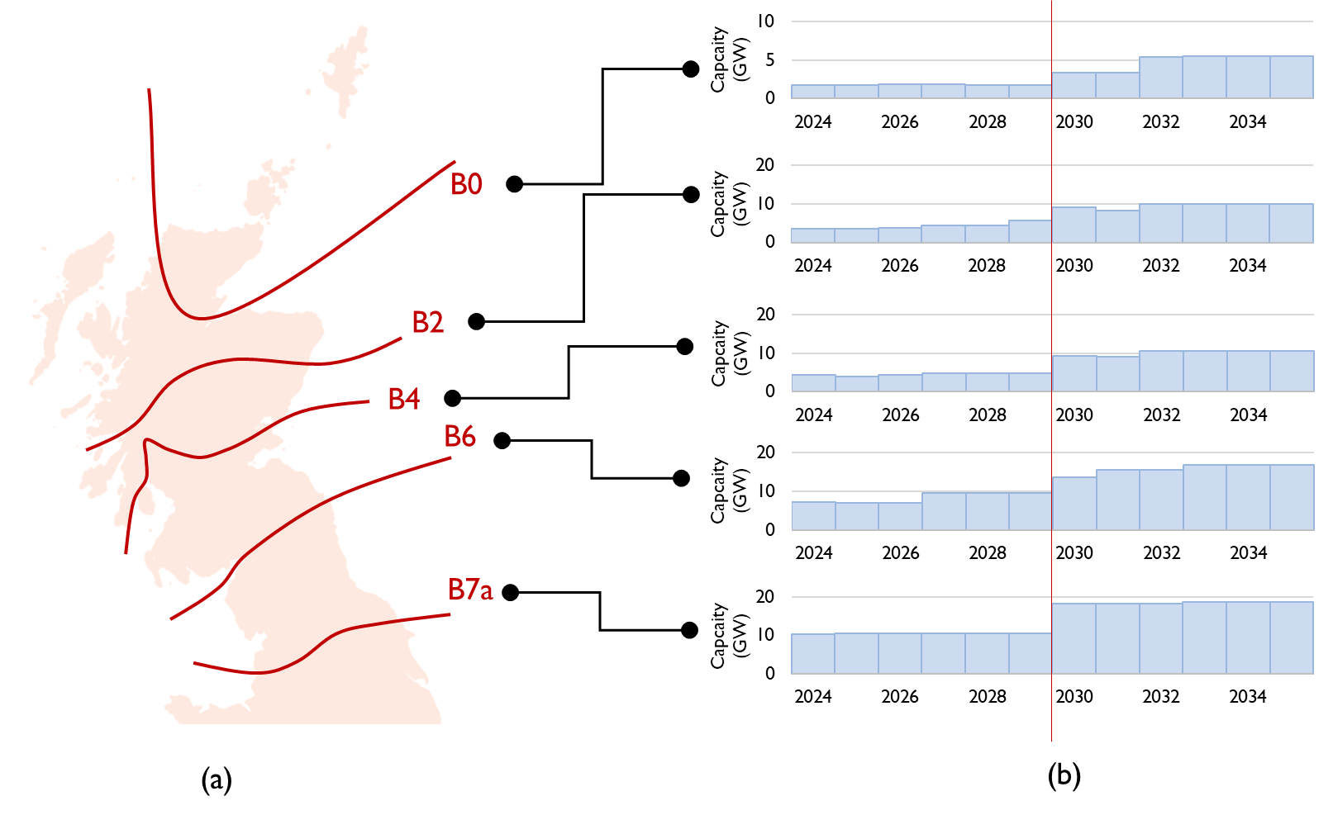
Constraints across all boundaries are expected to grow
And significant upgrades are required across individual boundaries. In the early 2030s it is likely that B2,
B4 and B7a will be important ‘pinch points’ as well as B6.

Slide 18
Why is this a problem?
Constraint costs for consumers is currently around £1 bn / year with the potential to rise to £3 bn / year in certain scenarios at the end of the decade (according the NGESO modelling).
Customers are exposed to significant risk associated with future constraint costs and the current
system has very few options to manage that risk on consumers’ behalf.
There is a perception is that this involves “paying wind farms not to generate” and that “it is the fault of the wind sector”
NGESO is increasingly struggling to manage system constraints and points to the challenge of multi- GW re-dispatch after gate closure, with only 1 hour lead time.
Conclusion is: we need a better system!

Slide 19
Recommendations
public more info
analysis lead times
Develop a portfolio
NGESO need to publish more information on their analysis of future constraints to help the sector understand the structure of constraints and assumptions that go into the forecasts used to justify decisions on transmission investment, market design.
4 Define the objective
5 Upwards and downwards
6 Multiple time frames
7 Long term contracting
Day ahead and intraday
Availability / utilisation
Explicitly traded interconnectors
Interconnector export group
Understand interactions

Slide 20
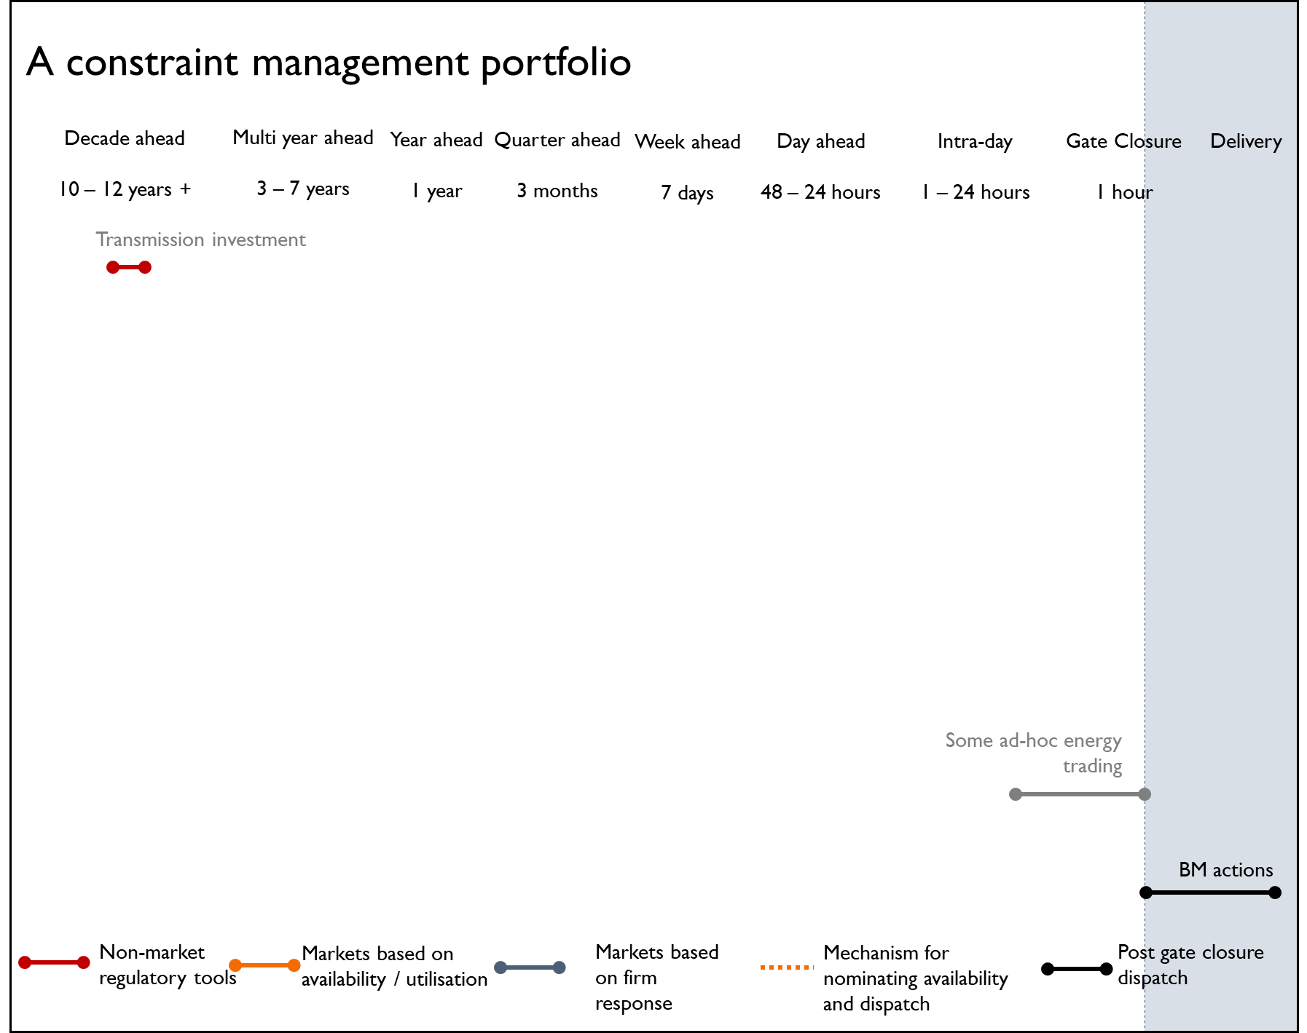
Recommendations
1 public more info
2 analysis lead times
How we manage constraints today
3 Develop a portfolio
Define the objective
Upwards and downwards
Multiple time frames
Long term contracting
Day ahead and intraday
Availability / utilisation
Explicitly traded interconnectors
Interconnector export group
Understand interactions

Slide 21
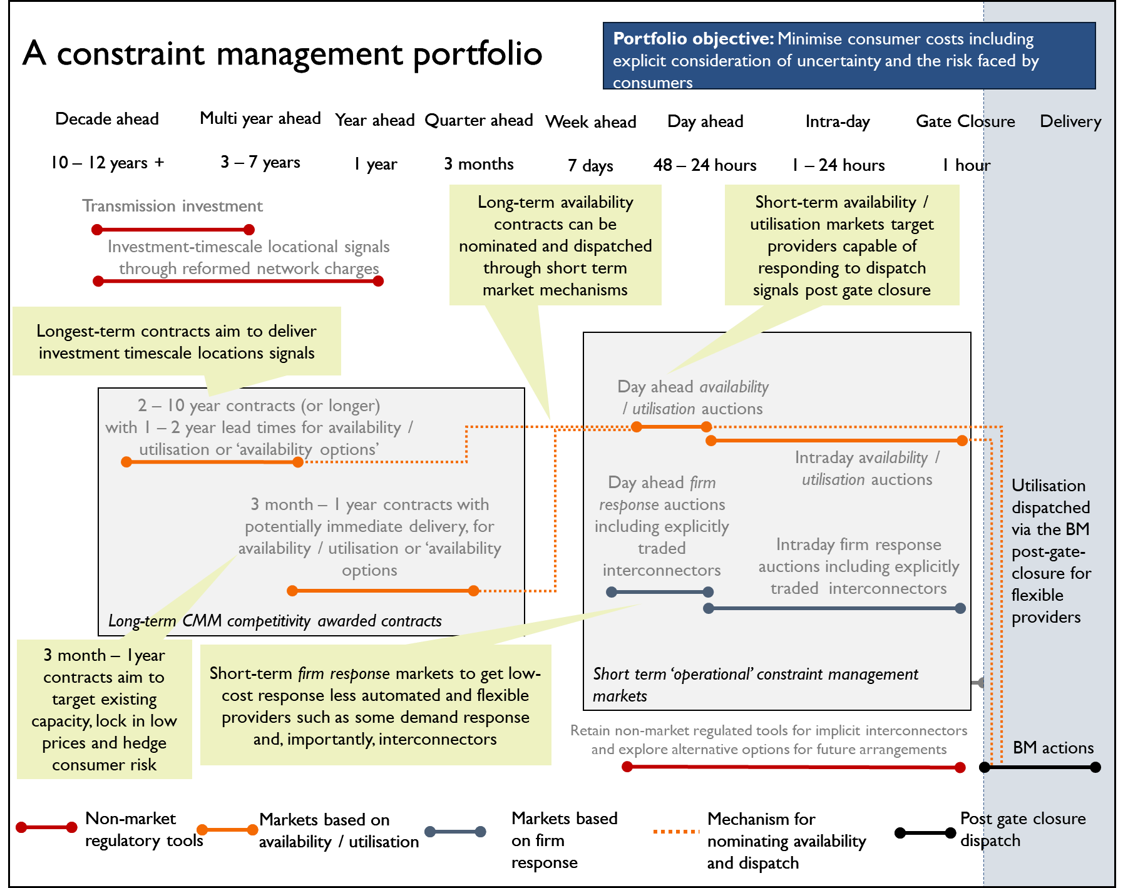
Recommendations
public more info
analysis lead times
Develop a portfolio
Define the objective
Upwards and downwards
Multiple time frames
Long term contracting
Day ahead and intraday
Availability / utilisation
Explicitly traded interconnectors
Interconnector export group
Understand interactions

Slide 22
Recommendations
1 public more info
How might a long term CMM work? *** Illustrative example only ***
NGESO offer tenders for constraint management:
2 analysis lead times
3 Develop a portfolio
Lead time for delivery (could range from close-to instant to several year lag)
Duration of contract (could be months to years)
Contract could be of the form:
4 Define the objective
5 Upwards and downwards
I agree to be available to provide X MW of turn down [or turn up] for
constraint management for Y hours during 20XX.
The price per hour of availability will by £ Z / MW / hour.
The Y hours of availability procured are on a ‘take or pay’ basis.
6 Multiple time frames
7 Long term contracting
The price per MWh of utilisation £ U / MWh
NGESO will run a process to nominate hours for availability at day ahead stage
NGESO will dispatch response at gate closure during nominated availability
hours
During hours which are not nominated for availability, or during hours which are nominated but response is not dispatched, I am free to operate at any level
8 Day ahead and intraday
9 Availability / utilisation
10 Explicitly traded interconnectors
Interconnector export group
Understand interactions

Slide 23
Recommendations
1 public more info
Day ahead auction for upward and downward constraint management actions
(Likely ‘availability / utilisation’ auction with utilisation dispatched around gate closure)
Intraday auction as
required
Dispatch at or after gate
closure
2 analysis lead times
3 Develop a portfolio
4 Define the objective
5 Upwards and downwards
6 Multiple time frames
7 Long term contracting
E.g. Auction held at 7 am for all hours the following
day
E.g. 2 or 3 additional auction with last 3 hours
ahead of gate closure
Dispatch instruction sent with circa 30 minutes notice
8 Day ahead and intraday
9 Availability / utilisation
10 Explicitly traded interconnectors
Very similar to current ancillary service market
Based closely on the new Balancing reserve market
Could be supplemented by a ‘firm response’ services as well similar to the current Local Constraint Market
11 Interconnector export group
12 Understand interactions

Slide 24

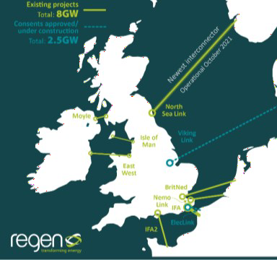


Next steps
We are speaking to EEZNZ REMA teams next week
We are engaging with ESO through the Constraints Collaboration Process
We will be working with the SR membership
We are looking at ways to engage with the interconnector community

Slide 25

Dr. Simon Gill
The Energy Landscape Ltd t: 07990668445
e: simon@energylandscape.co.uk
l: https://www.linkedin.com/in/simon-gill-energy/

Slide 26
Economics & markets policy
Update

Slide 27
Scottish government lmp review
Scottish Government has commissioned ERM via ClimateXChange to undertake a review of GB wholesale electricity market reform. The review focuses on the potential impacts on Scotland of a move to locational marginal pricing. SR has been feeding into the review as a key stakeholder.
Provisional conclusions presented to stakeholders indicate that that a scenario where LMP is implemented alongside mitigating measures to protect Scottish generation has been given the most favourable assessment.
SR has challenged this conclusion, strongly voicing our opposition to LMP and has recommended several amendments to be reflected in the final report, including:
  ScotGov should not support LMP unless and until a credible support mechanism (e.g., a reformed CfD) has been developed in full, its implementation has been committed to by the UK Government and it has been demonstrated to come at an acceptable cost to consumers.
  Implementing LMP whilst attempting to insulate Scottish generation would be costly, potentially unworkable and inherently contradictory.
  A BAU+ scenario should be highlighted as an appropriate counterfactual.
  It is unclear how LMP could align with strategic planning of the electricity system or be implemented in time to contribute to medium-term decarbonisation targets
ERM are currently finalising their report to Scottish Government. This report will be published once reviewed by Scottish Government (date not confirmed).

Slide 28
CfD sustainable industry reward
DESNZ consulted on proposals to introduce a ‘Sustainable Industry Reward’ (previously non-price factors) to the CfD scheme. The consultation sought views on the model for implementing the SIR as well as the proposed SIR criteria.
SR’s response to this consultation included the following key points:
  We welcomed the policy intent and reiterated the critical importance of delivering measures which lead to meaningful development the UK offshore wind supply chain.
  The SIR should form part of a wider industrial strategy that aligns with measures such as the Industrial Growth Plan and Strategic Investment Model.
  Fixed bottom and floating offshore wind should have separate funding pots to reflect differences in supply chains and maturity of technologies.
  Limitations of investment focused SIRs due to timing of CfD. Sustainability SIRs better suited to assessment at CfD stage.
  Introducing SIR for AR7 is ambitious with potential for unintended consequences given many outstanding design decisions. AR7 should be ‘soft launch’ with full implementation in AR8.
  Highlighted advantages and disadvantages of proposal to move SIR allocation to after CfD award.
  Strongly opposed option for minimum standards which would require developers to win SIR funding in order to be eligible for a CfD.
  Further clarity required over definition of ‘deprived areas’, key infrastructure should not be precluded from receiving funding. Recommended SME criterion not carried forward. Supported use of Carbon Trust JIP methodology to measure CO2 emissions. Supported use of science-based targets to assess sustainability but highlighted lengthy accreditation process.

Slide 29
AR7 and future rounds consultation (ongoing)
Repowering
  Supportive of proposals to allow fully repowered projects to participate in CfD. Some older projects will have shorter operating lives than 25 years. Requirement to maintain current capacity is unnecessary.
Appeals
  Favour Option 1: publish a fixed timeline. Option 2 would mean it less likely that a developer would be able to participate in an AR. Option 3 would bring forward deadline to a significantly earlier point in the annual auction cycle.
Phased CfDs for floating offshore wind
  Support the introduction of phasing policy for FOW. 1500MW cap should be lifted for both floating and fixed bottom projects.
Co-located generation and hybrid metering
  Agree that introducing hybrid metering would support innovation and more flexible use of CfD-supported renewable generation.
Supporting innovation in floating offshore wind foundation technology
  In principle support focusing on defining ‘established fixed-bottom’ but highlight this will be challenging in practise. Fixed foundation designs which are not established should not be able to compete with floating foundation technologies.
Supporting delivery of improved coordination of offshore transmission infrastructure
  Agree with DESNZ’s assessment that no change in regulations is required to support eligibility of bootstrap-connected projects.
  Support the CfD being used to support MPI-OFW but highlighted potential for perverse incentives if bespoke arrangements required.
Updating indexation to better reflect inflation risks
  Support in principle measures to ensure indexation better tracks inflation but recommend that Producer Price Index is not carried forward.

Slide 30
LDES consultation (ongoing)
DESNZ is consulting on their minded to position to introduce a Cap and Floor mechanism to enable investment in Long Duration Electricity Storage.
Emerging points in draft response:
  Policy objectives: agree with policy goals as set out in the consultation.
  LDES targets: agree that targets are not needed at this stage. Suggest publishing ‘ambition’ could be helpful.
  Cap and Floor regime: support the introduction of a Cap and Floor approach.
  Qualifying LDES technologies: support exclusion of already viable BESS technologies and agree with proposed 6-hour minimum cycle duration. Support two streams for established and novel technologies.
  Cap and Floor regime delivery: agree it should be an administrative regime.
  Cap and Floor eligibility: support eligibility largely as proposed in consultation document.
  Scheme funding: propose scheme should be managed through TNUoS as for interconnectors

Slide 31
coming up

Slide 32
Coming up
Economics and markets
LDES consultation (due 5 March)
AR7 and future rounds consultation (due 7 March)
CfD AR6 statutory notices and and Allocation Framework (13 March)
CfD SIR draft legislation (mid-March)
REMA second consultation (‘early 2024’)
Publication of ClimateXChange review of LMP (unconfirmed)
Across the wider sr team
Nominations for Young Professionals Green Energy Awards close today

Slide 33




15 FEBRUARY | GLASGOW
GRID & NETWORKS CONFERENCE 2024
6 MARCH | GLASGOW
PLANNING THE ENERGY TRANSITION SEMINAR
NEW FOR 2024!
19 MARCH | GLASGOW
SCOTLAND'S ENERGY TRANSITION SHOWCASE
DETAILS COMING SOON
MAY | EDINBURGH
FINANCE & INVESTMENT EVENT

